Slide 1
CACHE MEMORY

Slide 2

Cache Memory
Small amount of fast memory, expensive memory
Sits between normal main memory (slower) and CPU
May be located on CPU chip or module
It keeps a copy of the most frequently used data from the main memory.
Reads and writes to the most frequently used addresses will be serviced by the cache.
We only need to access the slower main memory for less frequently used data.

Slide 3
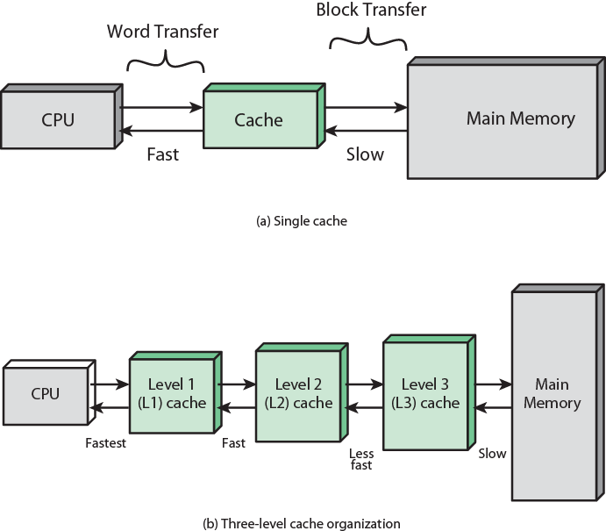


Slide 4
Principle of Locality
In practice, most programs exhibit locality, which the cache can take advantage of.
The principle of temporal locality says that if a program accesses one memory address, there is a good chance that it will access the same address again.
The principle of spatial locality says that if a program accesses one memory address, there is a good chance that it will also access other nearby addresses.

Slide 5
Temporal Locality in Programs and Data
Programs: Loops are excellent examples of temporal locality in programs.
  The loop body will be executed many times.
  The computer will need to access those same few locations of the instruction memory repeatedly.
Data: Programs often access the same variables over and over, especially within loops.

Slide 6
Spatial Locality in Programs and Data
Programs: Nearly every program exhibits spatial locality, because instructions are usually executed in sequence—if we execute an instruction at memory location i, then we will probably also execute the next instruction, at memory location i+1.
Code fragments such as loops exhibit both temporal and spatial locality.
Data: Programs often access data that is stored contiguously.
  Arrays, like a in the code on the top, are stored in memory contiguously.
  The individual fields of a record or object like employee are also kept contiguously in memory.

Slide 7
How caches take advantage of temporal locality
The first time the processor reads from an address in main memory, a copy of that data is also stored in the cache.
  The next time that same address is read, we can use the copy of the data in the cache instead of accessing the slower dynamic memory.
  So the first read is a little slower than before since it goes through both main memory and the cache, but subsequent reads are much faster.

Slide 8
How caches take advantage of spatial locality
When the CPU reads location i from main memory, a copy of that data is placed in the cache.
But instead of just copying the contents of location i, we can copy several values into the cache at once, such as the four bytes from locations i through i + 3.
  If the CPU later does need to read from locations i + 1, i + 2 or i + 3, it can access that data from the cache and not the slower main memory.
  For example, instead of reading just one array element at a time, the cache might actually be loading four array elements at once.
Again, the initial load incurs a performance penalty, but we’re gambling on spatial locality and the chance that the CPU will need the extra data.

Slide 9
Hits and Misses
A cache hit occurs if the cache contains the data that we’re looking for.
  cache can return the data much faster than main memory.
A cache miss occurs if the cache does not contain the requested data.
  CPU must then wait for the slower main memory.

Slide 10
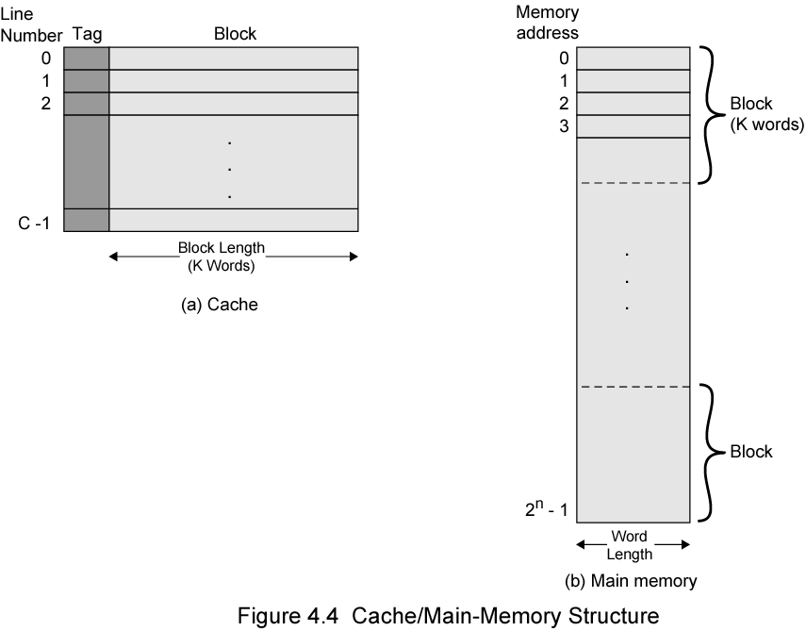
Cache/Main Memory Structure

Slide 11
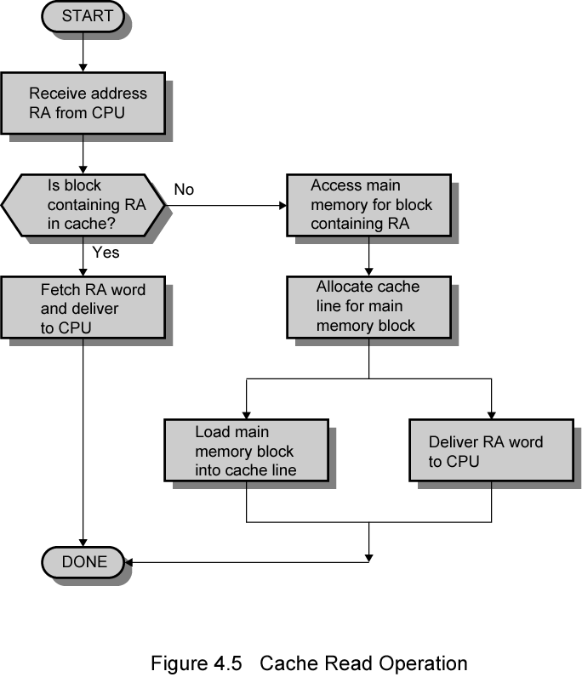
Cache read operation
CPU requests contents of memory location
Check cache for this data
If present, get from cache (fast)
If not present, read required block from main memory to cache
Then deliver from cache to CPU
Cache includes tags to identify which block of main memory is in each cache slot

Slide 12
Size of Cache Design
Cost
  More cache is expensive
Speed
  More cache is faster (up to a point)
  Checking cache for data takes time

Slide 13

Typical Cache Organization

Slide 14
Comparison of Cache Sizes
Processor
Type
Year of Introduction
L1 cachea
L2 cache
L3 cache
IBM 360/85
Mainframe
1968
16 to 32 KB
—
—
PDP-11/70
Minicomputer
1975
1 KB
—
—
VAX 11/780
Minicomputer
1978
16 KB
—
—
IBM 3033
Mainframe
1978
64 KB
—
—
IBM 3090
Mainframe
1985
128 to 256 KB
—
—
Intel 80486
PC
1989
8 KB
—
—
Pentium
PC
1993
8 KB/8 KB
256 to 512 KB
—
PowerPC 601
PC
1993
32 KB
—
—
PowerPC 620
PC
1996
32 KB/32 KB
—
—
PowerPC G4
PC/server
1999
32 KB/32 KB
256 KB to 1 MB
2 MB
IBM S/390 G4
Mainframe
1997
32 KB
256 KB
2 MB
IBM S/390 G6
Mainframe
1999
256 KB
8 MB
—
Pentium 4
PC/server
2000
8 KB/8 KB
256 KB
—
IBM SP
High-end server/ supercomputer
2000
64 KB/32 KB
8 MB
—
CRAY MTAb
Supercomputer
2000
8 KB
2 MB
—
Itanium
PC/server
2001
16 KB/16 KB
96 KB
4 MB
SGI Origin 2001
High-end server
2001
32 KB/32 KB
4 MB
—
Itanium 2
PC/server
2002
32 KB
256 KB
6 MB
IBM POWER5
High-end server
2003
64 KB
1.9 MB
36 MB
CRAY XD-1
Supercomputer
2004
64 KB/64 KB
1MB
—

Slide 15
Direct Mapping
Each block of main memory maps to only one cache line
  i.e. if a block is in cache, it must be in one specific place
Address is in two parts
Main Memory address
Tag
Line / Slot
Line/Slot | Tag | Memory Content
000
001
010
:
Cache address
Cache content

Slide 16
Example 1: Direct Mapping
A main memory contains 8 words while the cache has only 4 words. Using direct address mapping, identify the fields of the main memory address for the cache mapping.
Solution:
Total memory words = 8 = 2³ → Require 3 bit for main memory address.
Total cache words = 4 = 2² → Require 2 bit for cache address → line / slot
Main memory address = 3 bits
Tag = 1 bit
Line / Slot = 2 bits

Slide 17
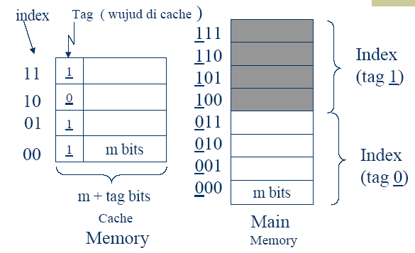
Example 1: Direct Mapping
Line/Slot
Line/Slot
Line/Slot

Slide 18
Example 2: Direct Mapping
A main memory system has the following specification:
Main memory contain 16 words, each word is 16 bit long
Cache memory contain 4 words, each word is 16 bit
Identify the size (bits) of tag and line fields of the cache memory.
What is the size of the cache word?
Draw the memory system and specify the related address fields.

Slide 19
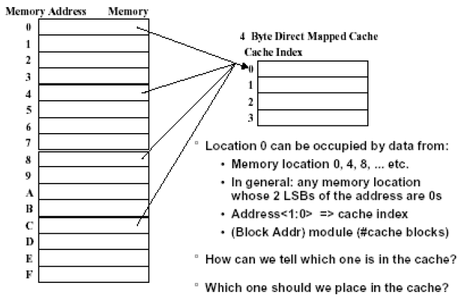
Example 2: Direct Mapping Address

Slide 20
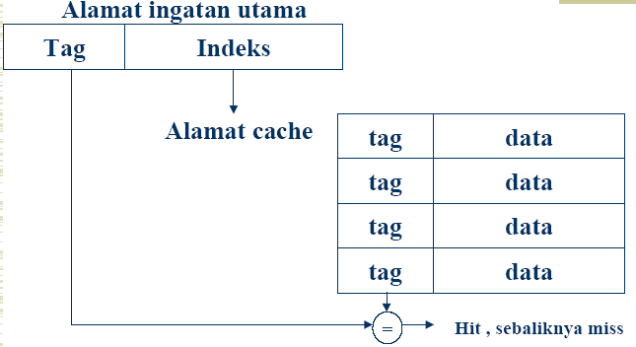
Direct Mapping: Hit or Miss
Memory Address
Line/Slot
Cache Address

Slide 21
Block Direct Mapping
Memory Address
Tag
Line/Slot/Block
Word
Tag | Word 1 | Word 2 | Word 3 | Word 4

Slide 22
Example: Derive Index(Block) and Offset (Word bits). Given
Memory size = 256KB = 2 ¹⁸
Block size = 32Bytes = 2 ⁵
Number of blocks in cache = Cache size/Block size = 64KB/32B = 2¹⁶/2 ⁵ = 2¹¹
Number of bits in Tag = Total bits - Index bits - Offset bits = 18-11-5 = 2

Slide 23
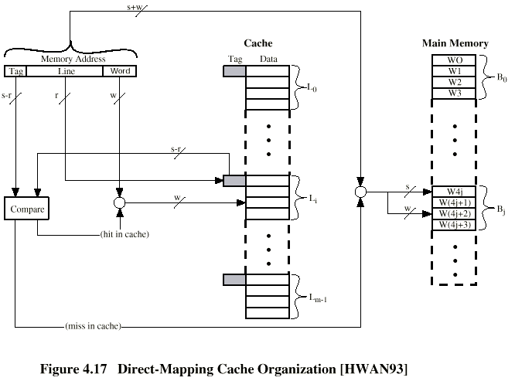

Slide 24
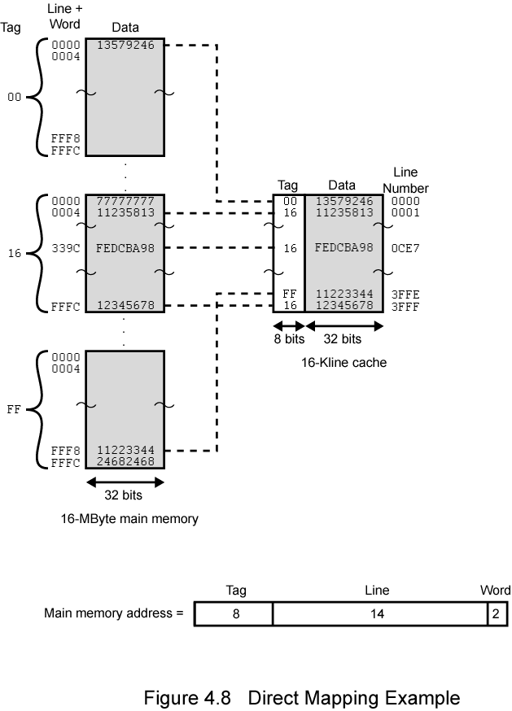

Slide 25
Direct Mapping pros & cons
Simple
Inexpensive
Fixed location for given block
  If a program accesses 2 blocks that map to the same line repeatedly, cache misses are very high

Slide 26
Associative Mapping
A main memory block can load into any line of cache
Memory address is interpreted as tag and word
Tag uniquely identifies block of memory
Every line’s tag is examined for a match
Cache searching gets expensive
Main memory address
Tag
Word

Slide 27


Slide 28
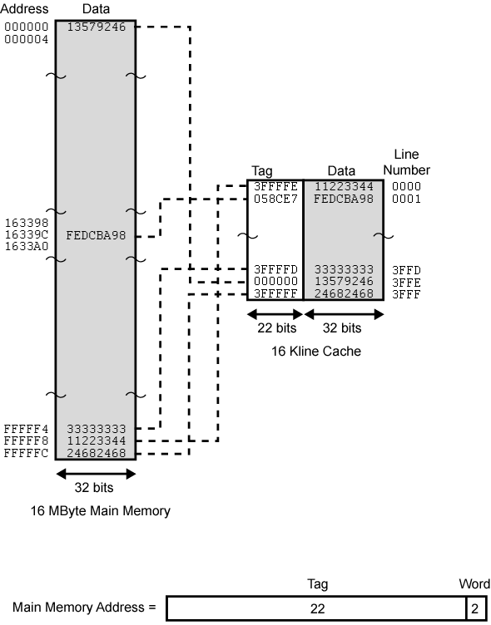

Slide 29
Example: Given M.M= 16MB, Cache has 16K Lines, Block Size=4words, Devise Memory address format
(a). Main memory capacity = 16MByte = 16 * 1MByte = 2⁴ * 2²⁰ = 2²⁴
Therefore the number of bits for the main memory address = 24 bits
(b) Given a cache memory of the size 16 Kline = 16 * Kline = 2⁴ * 2¹⁰ = 2¹⁴ locations (line number) – not important…! (Since the any word can be loaded into any cache location)
(c) Each line stores a block of words.
Block size = 4 words (4x8bit=32bit) = 2² words
Therefore 2 bits for block of words

Slide 30
(d) Memory address format consists of tag and word field.
Tag bits + words bits = 24 bits
Tag bits + 2 = 24 bits
Therefore tag bits = 24 – 2 = 22 bits
Draw the format of main memory address
TAG=22bits | Word=2bits

Slide 31
Set Associative Mapping
Cache is divided into a number of sets
Each set contains a number of lines
A given block maps to any line in a given set
  e.g. Block B can be in any line of set i
e.g. 2 lines per set
  2 way set associative mapping
  A given block can be in one of 2 lines in only one set
Main memory address
Tag
Set/Index
Word

Slide 32
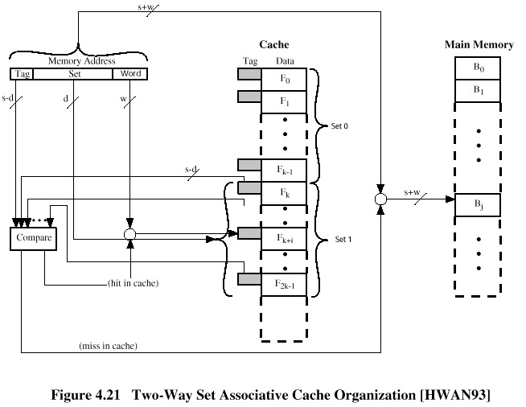

Slide 33
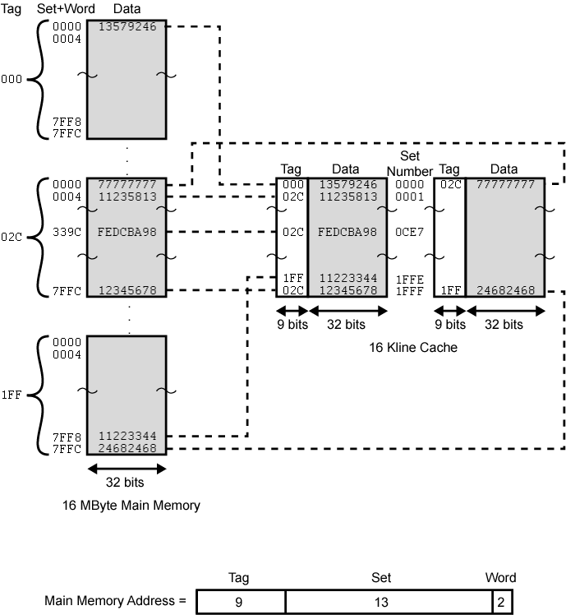

Slide 34
Set Associative Mapping
Example 1
Given memory size of 256KB, Cache size of 64KB, and memory block size of 2 Bytes, find the address format using 4-Way Set Associate Mapping ?
Solution:
Memory Size=256KB= 2¹⁸
Block Size(Offset) = 2 Bytes = 2¹
Cache Size = 64KB=2¹⁶
Set Size = 4 blocks
To find:
Number of Sets in Cache(Index) = 2¹⁶/(4*2)=2¹³
Number of bits in Tag = Total – Index-Offset = 18-13-1 = 4
Tag : 4 bits | Index: 13 bits | Offest : 1 bit

Slide 35
Set Associative Mapping Example 2
Given memory size of 256KB, Cache size of 64KB, and memory block size of 2 Bytes, find the address format using 8-Way Set Associate Mapping ?
Solution:
Memory Size=256KB= 2¹⁸
Block Size(Offset) = 2 Bytes = 2¹
Cache Size = 64KB=2¹⁶
Set Size = 8 blocks
To find:
Number of Sets in Cache(Index) = 2¹⁶/(8*2)=2¹²
Number of bits in Tag = Total – Index-Offset = 18-12-1 = 5
Tag : 5 bits | Index: 12 bits | Offest : 1 bit

Slide 36
Replacement Algorithms (1) Direct mapping
No choice
Each line/slot or block only maps to one line/slot or block
Replace that line/slot or block

Slide 37
Replacement Algorithms (2) Associative & Set Associative
Hardware implemented algorithm (speed)
Least Recently used (LRU)
First in first out (FIFO)
  replace block that has been in cache longest
Least frequently used (LFU)
  replace block which has had fewest hits
Random

Slide 38
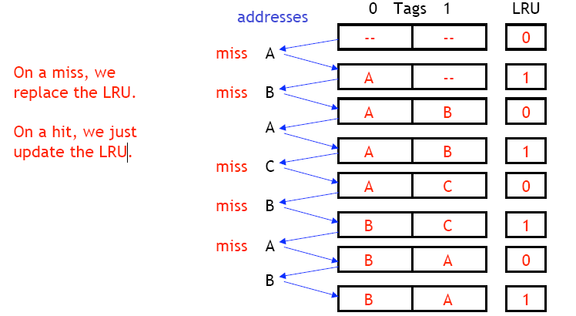
LRU Example
Assume a associative cache with two blocks, which of the following memory references miss in the cache
  assume distinct addresses go to distinct blocks

Slide 39
Write Policy
Must not overwrite a cache block unless main memory is up to date
Multiple CPUs may have individual caches
I/O may address main memory directly

Slide 40
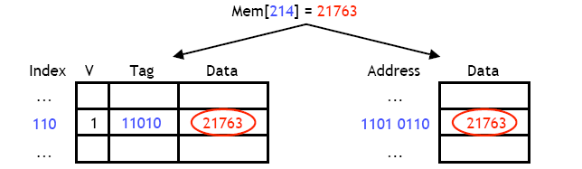
Write through
A write-through cache write updates both the cache and the main memory
Multiple CPUs can monitor main memory traffic to keep local (to CPU) cache up to date
Lots of traffic
Slows down writes

Slide 41
Write back
Updates initially made in cache only
Update bit for cache slot is set when update occurs
If block is to be replaced, write to main memory only if update bit is set
Other caches get out of sync
I/O must access main memory through cache

Slide 42
Cache Coherence
Assuming a system with multiple processors and multiple caches.
If a word in one cache is altered, then that word needs to be altered in :
  Main memory as well as other cache
Even with write-through policy other caches may contain invalid data.
Thus the problem is to maintain Cache Coherence.

Slide 43
Approaches for Cache Coherence
Bus watching with write through
  Each cache controller monitors the address lines to detect write operations to memory.
  If shared locations in memory are overwritten by another controller(master).
  Other cache controllers invalidate their corresponding cache entries.

Slide 44
Approaches for Cache Coherence (Cont’d)
Hardware Transparency
  All updates to main memory via cache are reflected in all caches.
  If one of the cache is updated :
    It is automatically written main memory as well as updating other caches.
Noncacheable Memory
  Chunks of main memory are designed as non-cacheable.
  Shared memory is noncacheable.
  All the access to the shared memory is cache misses.

Slide 45
Line Size
The relationship between block size and hit ratio is complex.
As block size increases the hit ratio will increase at first.
  Locality of reference comes into play
But very large block size will also decrease performance:
  Probability of newly fetched information becomes less.
  Blocks need to be replaced shortly after being brought in!

Slide 46
Line Size (Cont’d)
Optimal block size is a characteristic of the program.
Line size of 8 to 64 is optimal for normal usage.
For HPC systems, line size is 64- to 128 bytes.

Slide 47
Multilevel Caches
On-chip Cache – L1
Off-chip Cache – L2
  Static RAM, faster then system bus
  Separate data path, reduce burden on system bus
  A number of CPU have incorporated L2 on the CPU itself.
Off-chip Cache – L3
  L2 moves into CPU, L3 becomes external.
  Most recently, L3 also incorporated on the CPU.

Slide 48
Pentium 4 Cache
80386 – no on chip cache
80486 – 8k using 16 byte lines and four way set associative organization
Pentium (all versions) – two on chip L1 caches
  Data & instructions
Pentium III – L3 cache added off chip
Pentium 4
  L1 caches
    8k bytes
    64 byte lines
    four way set associative
  L2 cache
    Feeding both L1 caches
    256k
    128 byte lines
    8 way set associative
  L3 cache on chip

Slide 49
Intel Cache Evolution
Problem
Solution
Processor on which feature first appears
External memory slower than the system bus.
Add external cache using faster memory technology.
386
Increased processor speed results in external bus becoming a bottleneck for cache access.
Move external cache on-chip, operating at the same speed as the processor.
486
Internal cache is rather small, due to limited space on chip
Add external L2 cache using faster technology than main memory
486
Contention occurs when both the Instruction Prefetcher and the Execution Unit simultaneously require access to the cache. In that case, the Prefetcher is stalled while the Execution Unit’s data access takes place.
Create separate data and instruction caches.
Pentium
Increased processor speed results in external bus becoming a bottleneck for L2 cache access.
Create separate back-side bus that runs at higher speed than the main (front-side) external bus. The BSB is dedicated to the L2 cache.
Pentium Pro
Move L2 cache on to the processor chip.
Pentium II
Some applications deal with massive databases and must have rapid access to large amounts of data. The on-chip caches are too small.
Add external L3 cache.
Pentium III
Move L3 cache on-chip.
Pentium 4

Slide 50
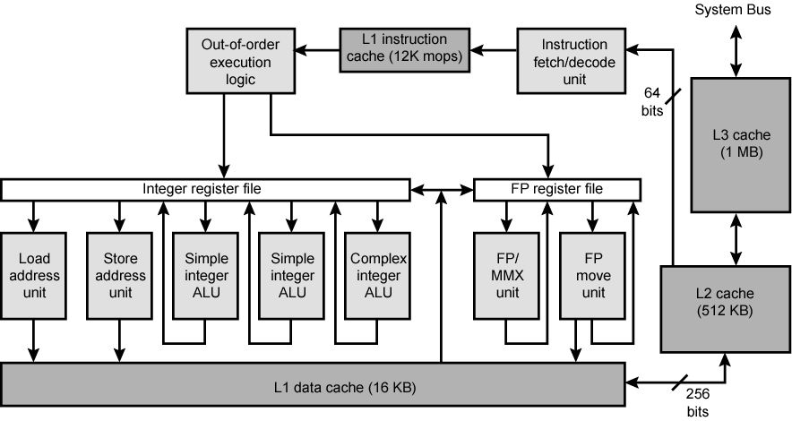
Pentium 4 Block Diagram

Slide 51
Pentium 4 Core Processor (Extra Notes)
Fetch/Decode Unit
  Fetches instructions from L2 cache
  Decode into micro-ops
  Store micro-ops in L1 cache
Out of order execution logic
  Schedules micro-ops
  Based on data dependence and resources
  May speculatively execute
Execution units
  Execute micro-ops
  Data from L1 cache
  Results in registers
Memory subsystem
  L2 cache and systems bus

Slide 52
Pentium 4 Design Reasoning (Extra Notes-Skip)
Decodes instructions into RISC like micro-ops before L1 cache
Micro-ops fixed length
  Superscalar pipelining and scheduling
Pentium instructions long & complex
Performance improved by separating decoding from scheduling & pipelining
  (More later – ch14)
Data cache is write back
  Can be configured to write through
L1 cache controlled by 2 bits in register
  CD = cache disable
  NW = not write through
  2 instructions to invalidate (flush) cache and write back then invalidate
L2 and L3 8-way set-associative
  Line size 128 bytes

Slide 53

PowerPC Cache Organization
601 – single 32kb 8 way set associative
603 – 16kb (2 x 8kb) two way set associative
604 – 32kb
620 – 64kb
G3 & G4
  64kb L1 cache
    8 way set associative
  256k, 512k or 1M L2 cache
    two way set associative
G5
  32kB instruction cache
  64kB data cache

Slide 54
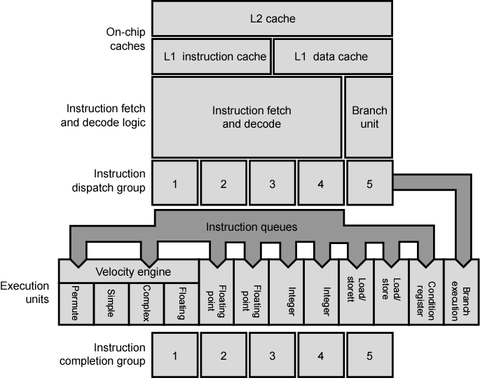
PowerPC G5 Block Diagram

Slide 55
Internet Sources
Manufacturer sites
  Intel
  IBM/Motorola
Search on cache

Slide 56
Memory System Performance
The hit time is how long it takes data to be sent from the cache to the processor. This is usually fast, on the order of 1-3 clock cycles
The miss penalty is the time to copy data from main memory to the cache. This often requires dozens of clock cycles (at least)
The miss rate is the percentage of misses

Slide 57
Average Memory Access Time
The average memory access time, or AMAT, can then be computed
AMAT = Hit time + (Miss rate x Miss penalty)
This is just averaging the amount of time for cache hits and the amount of time for cache misses
Obviously, a lower AMAT is better
Miss penalties are usually much greater than hit times, so the best way to lower AMAT is to reduce the miss penalty or the miss rate

Slide 58
Performance Example 1
Assume that 33% of the instructions in a program are data accesses. The cache hit ratio is 97% and the hit time is one cycle, but the miss penalty is 20 cycles.
AMAT = Hit time + (Miss rate x Miss penalty) = 1 cycle + (3% x 20 cycles) = 1.6 cycles
If the cache was perfect and never missed, the AMAT would be one cycle. But even with just a 3% miss rate, the AMAT here increases 1.6 times!

Slide 59
Memory and Overall Performance
The total number of stall cycles depends on the number of cache misses and the miss penalty.
    Memory stall cycles = Memory accesses x miss rate x miss penalty
To include stalls due to cache misses in CPU performance equations, we have to add them to the “base” number of execution cycles.
    CPU time = (CPU execution cycles + Memory stall cycles) x Cycle time

Slide 60
Performance Example 2
Assume that 33% of the instructions in a program are data accesses. The cache hit ratio is 97% and the hit time is one cycle, but the miss penalty is 20 cycles.
Memory stall cycles = Memory accesses x Miss rate x Miss penalty
= 0.33 I x 0.03 x 20 cycles
= 0.2 I cycles
If I instructions are executed, then the number of wasted cycles will be 0.2 x I.
This code is 1.2 times slower than a program with a “perfect” CPI of 1!

Slide 61
Performance Example 2
Processor performance traditionally outpaces memory performance, so the memory system is often the system bottleneck.
For example, with a base CPI of 1, the CPU time from the last page is:
CPU time = (I + 0.2 I) x Cycle time
What if we could double the CPU performance so the CPI becomes 0.5, but memory performance remained the same?
CPU time = (0.5 I + 0.2 I) x Cycle time
The overall CPU time improves by just 1.2/0.7 = 1.7 times!

Slide 62
Peformance Example 2
A CPU has access to 2 levels of memory. Level 1 contains 1000 words and has access time 0.01 μs; level 2 contains 100,000 words and has access time 0.1 μs. Assume that if a word to be accessed is in level 1, then, the CPU accesses it directly. If it is in level 2, then the word is first transferred to level 1 and then accessed by the CPU. For simplicity, we ignored the time required for the CPU to determine whether the word is in level 1 or level 2.
Suppose 95% of the memory access are found in the cache. Then, the average access to a word can be expressed as:

Slide 63
Peformance Example 3
(0.95)(0.01 μs) + (0.05)(0.01 μs +0.1 μs)
= 0.0095 + 0.0055
= 0.015 μs.

